Slide 1


Hotel Booking Analysis Project
Text & Diagram Report | June 2025
by Mitali Choudhari

Slide 2

Project Introduction
1
Data Scope
119,390 hotel bookings analyzed.
2
Key Data
Guest details, preferences, status.
3
Goal
Uncover patterns, improve service.

Slide 3





Core Objectives
Booking Trends
Identify distribution & seasonality.
Cancellations
Analyze behavior & implications.
Room Mismatch
Compare reserved vs. assigned rooms.
Guest Preferences
Understand meal & channel choices.

Slide 4
Key Insights
1
Hotel Type
City hotels more bookings.
2
Peak Season
July is peak booking month.
3
Cancellations
~37% of bookings cancelled.
4
Meal Plan
'BB' (Bed & Breakfast) preferred.
5
Room Issues
Frequent reserved vs. assigned mismatch.

Slide 5

Strategic Recommendations
Reduce Cancellations
Flexible policies or advance deposits.
Address Room Issues
Investigate assignment problems.
Boost Off-Peak
Promotions during low seasons.
Customize Meals
Match guest preferences.

Slide 6
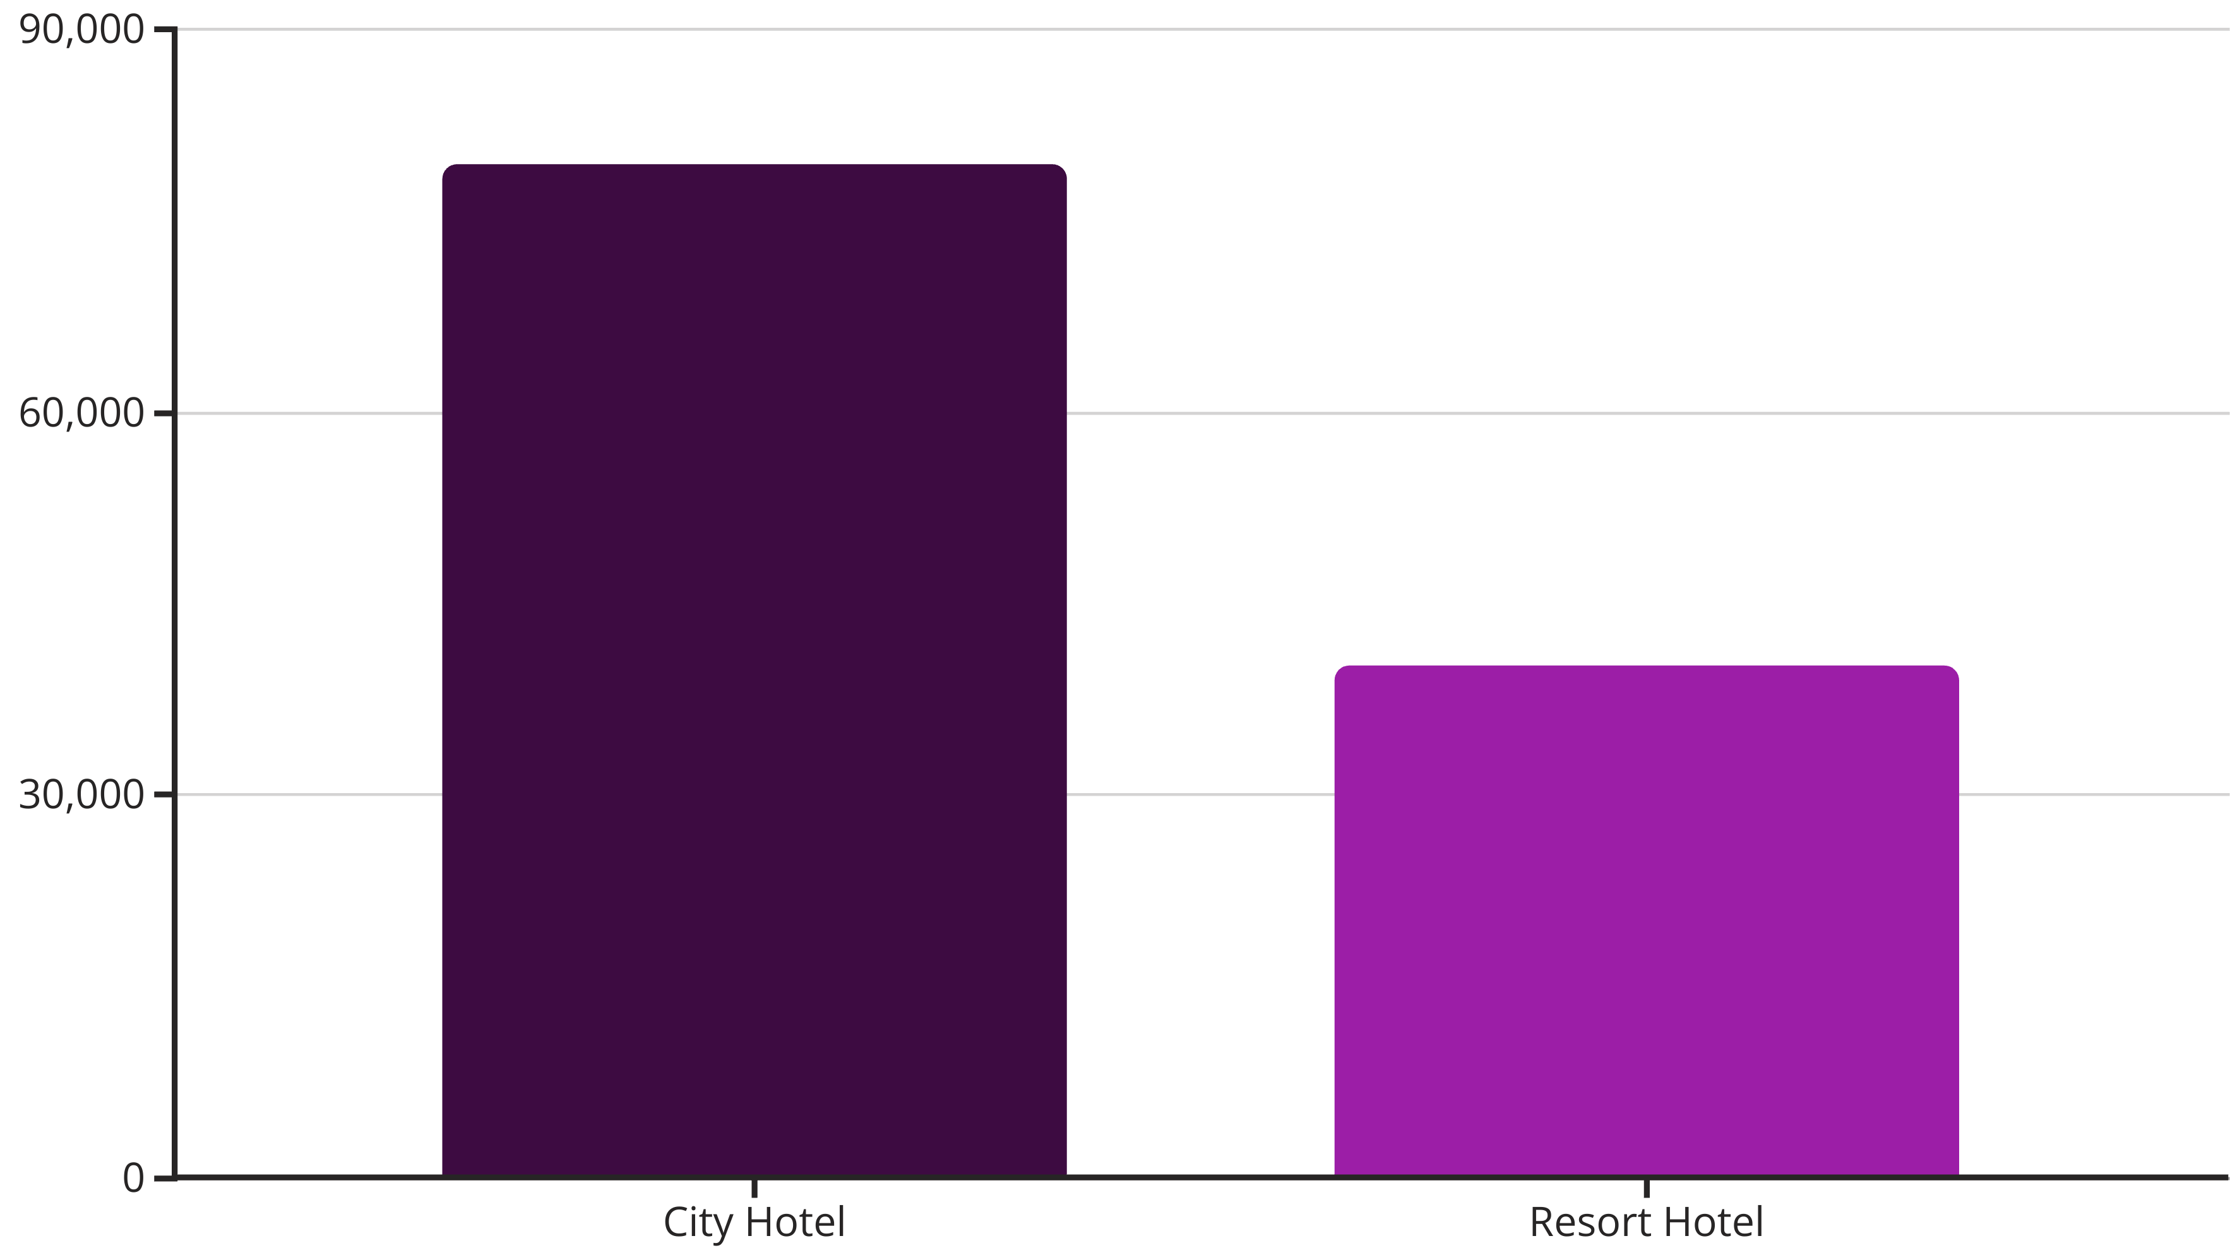
Booking Distribution
City hotels are booked more frequently than resort hotels.

Slide 7
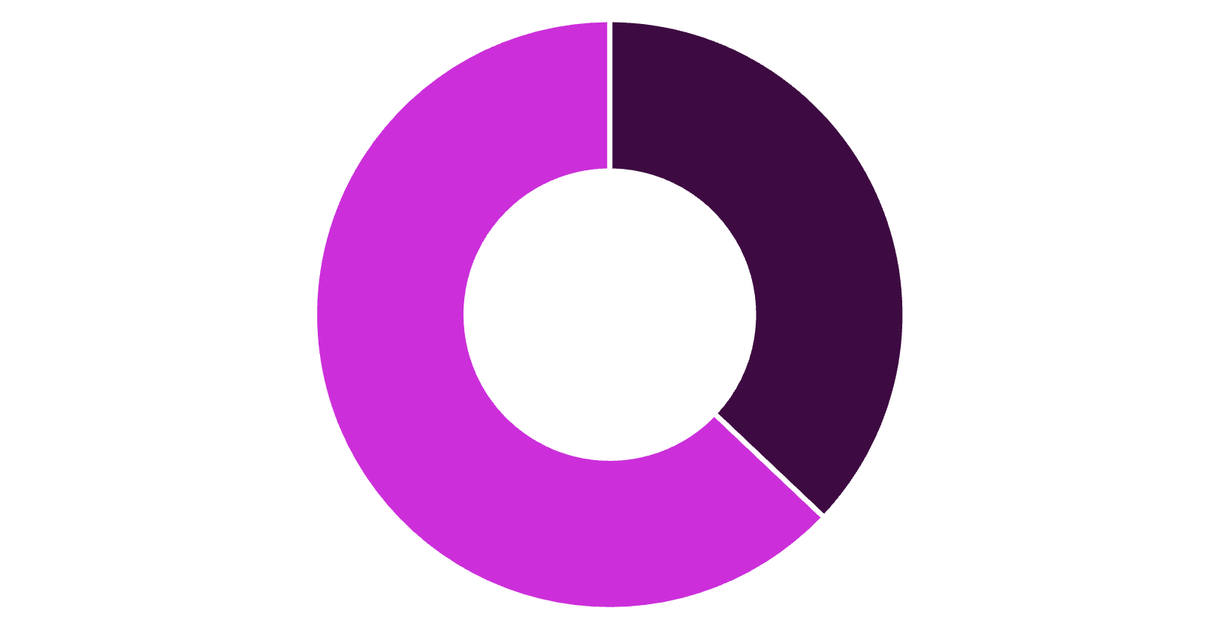
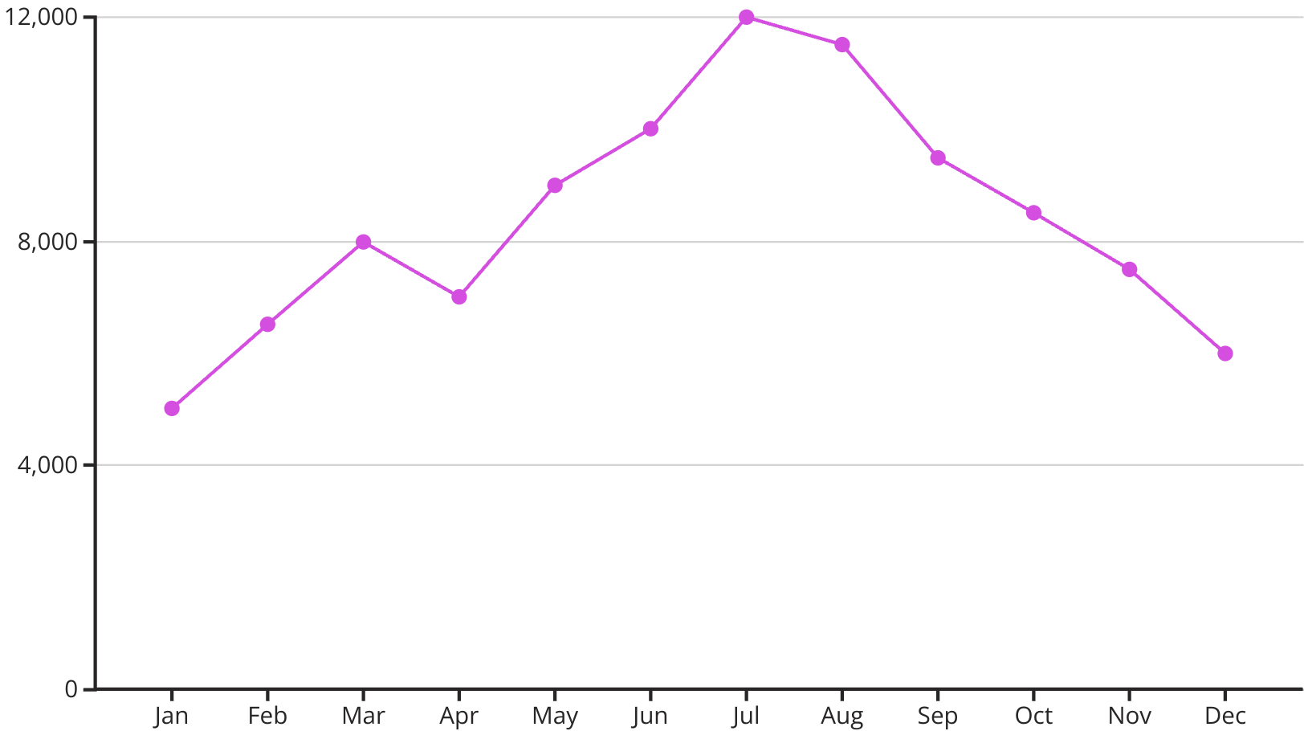
Cancellation Rate & Monthly Trends
Cancelled
Not Cancelled
Approximately 37% of bookings are cancelled.
Peak bookings in July and August, showing seasonality.

Slide 8

Conclusion & Next Steps
Valuable Trends
Enhance Experience
Data reveals insights in operations & behavior.
Insights can boost guest experience & revenue.
Future Work
Predictive modeling for cancellations & demand.

Slide 9
Thank You

